Slide 1

Diagnosing skin conditions using images
Team name : Black Squad
Team No : 24 RMKCET

Slide 2
Team members name | Mail id | Team faculty mentors | Faculty mentor mail ID | Cognizant mentor name | Cognizant mentor mail ID
Thiruvikram Choudry B | thir20ad050@rmkcet.ac.in | Maria Michael Visuwasam | mariamichaelads@rmkcet.ac.in | Suvabrata Mitra | suvabratra.mitra@cognizant.com
Sharavanan L | shar20ad044@rmkcet.ac.in
Sirajudeen A | sira20ad045@rmkcet.ac.in
Team details
Team Name – Black Squad
Team No – 24
RMKCET / RMKEC -RMKCET

Slide 3


PROBLEM STATEMENT
Skin diseases are a common medical concern affecting millions of individuals worldwide. Skin diseases may be caused by fungal infection, bacteria, allergy, or viruses, etc.
The advancement of medical technology has made it possible to diagnose the skin diseases but the cost of such diagnosis is very expensive.
To Develop an AI-powered system for diagnosing skin conditions using images, aiming to improve the accuracy and efficiency of dermatological assessments.

Slide 4


CHALLENGES
SOLUTION
Free chatbots and cheap doctor consultations.
Skin percentage prediction.
Skin cancer prediction.
Predicting the effect of cancer and providing medical professionals.
Hashing user authentications and user control privacy method.
Diagnosis is Expensive.
Image clarity issue.
Handling cancerous disease.
Identifying effect of cancer.
Privacy and security concerns.

Slide 5
GOALS
Accuracy
Privacy
The goal is to create a reliable application that can assist individuals in identifying various skin conditions, such as acne, psoriasis, infections, skin cancer and other dermatological disorders.
User-Friendly
Free of cost
Efficient

Slide 6
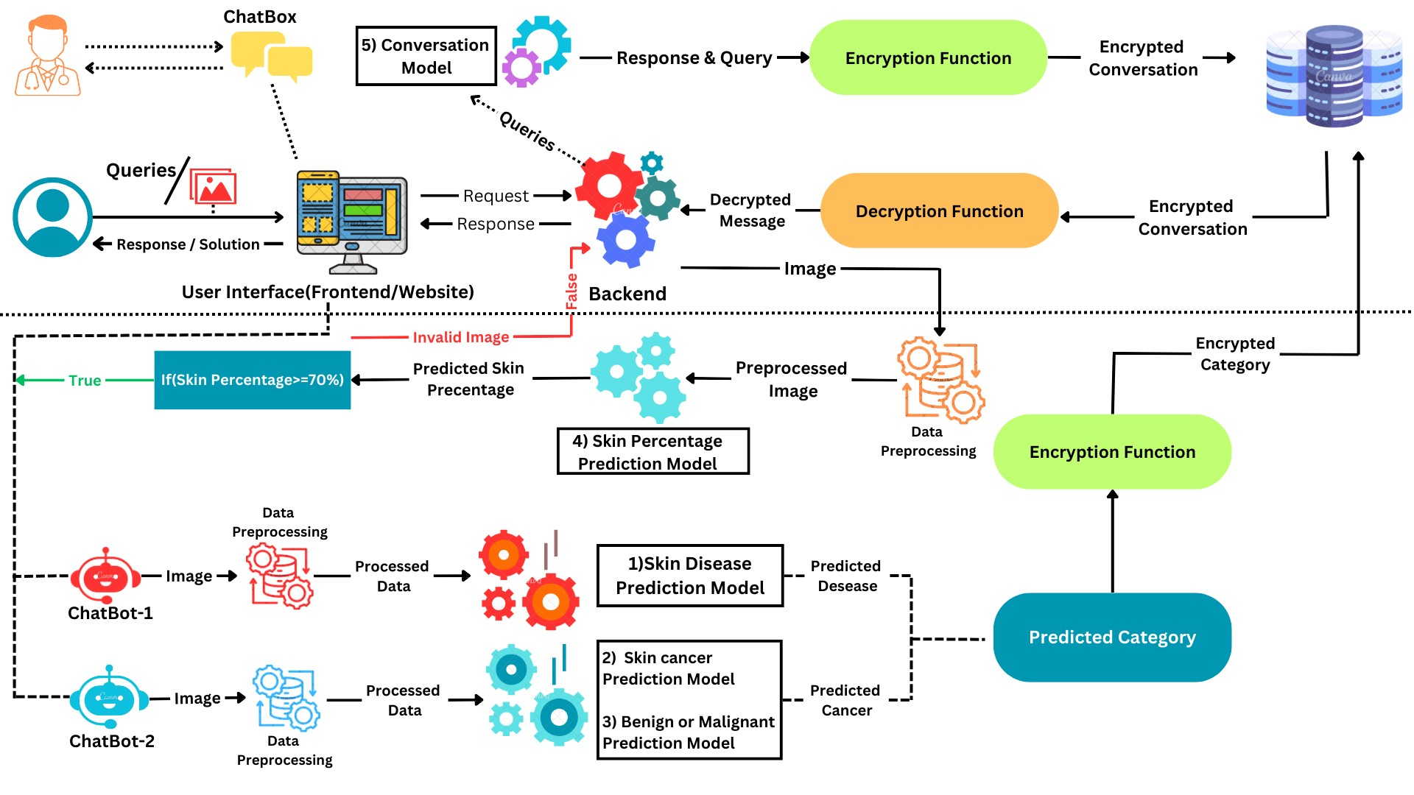
ARCHITECTURE DIAGRAM

Slide 7
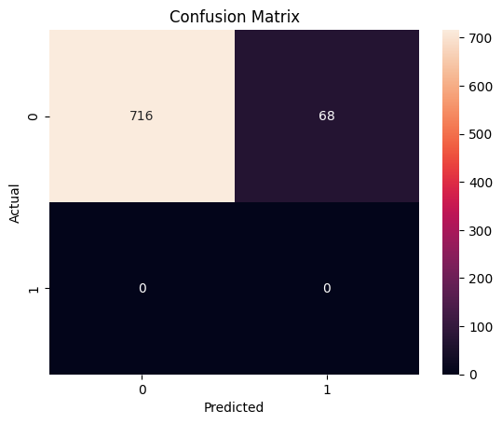
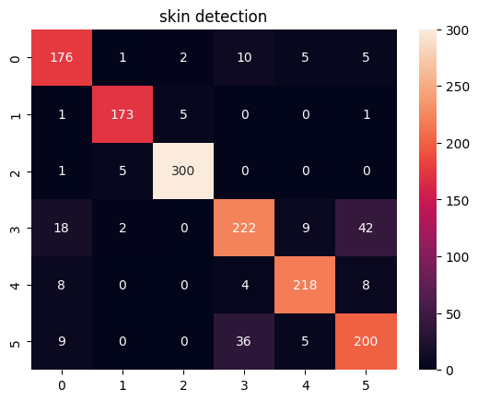
MACHINE LEARNING MODEL’S
SKIN PERCENTAGE PREDICTION MODEL:
ALGORITHM : Random Forest Algorithm
DATASET : Skin Segmentation (UC - Irvine)
No. OF CLASSES : 2
ACCURACY : 91.76%
F1- SCORE : 0.95
SKIN DISEASE PREDICTION MODEL:
ALGORITHM : CNN (VGG16)
DATASET : Dermnet (Kaggle)
No. OF CLASSES: 6
ACCURACY : 76.23%
F1- SCORE : 0.7956%

Slide 8
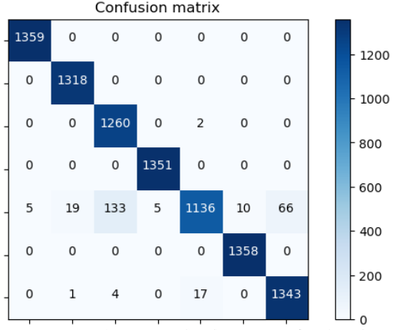
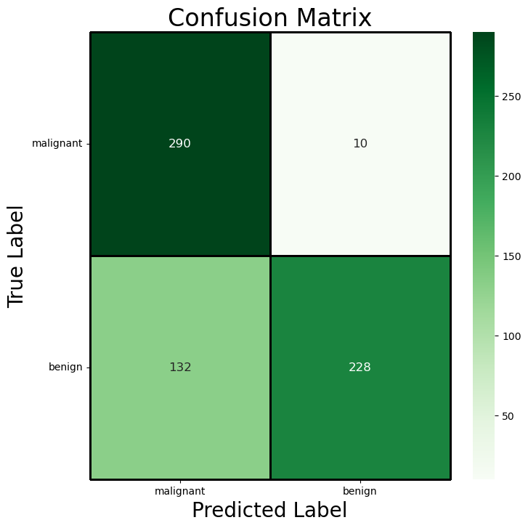
MACHINE LEARNING MODEL’S
3) SKIN CANCER PREDICTION MODEL:
ALGORITHM : CNN (Sequential)
DATASET : HAM10000 (Kaggle)
No. OF CLASSES : 7
ACCURACY : 91.08%
F1- SCORE : 0.9249
4) BENIGN / MALIGNANT PREDICTION MODEL:
ALGORITHM : CNN (Sequential)
DATASET : Malignant vs Benign
No. OF CLASSES : 2
ACCURACY : 78.76%
F1- SCORE : 0.8331

Slide 9
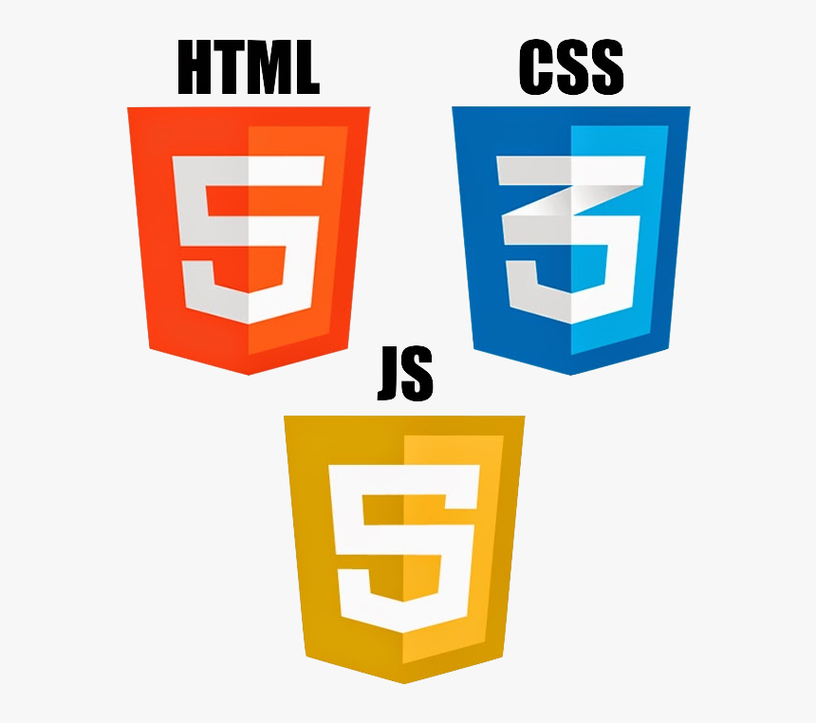









TECH STACK & LIMITATIONS
FRONT END & BACKEND FRAMEWORK: HTML CSS JAVASCRIPT DJANGO | PROGRAMMING LANGUAGES & MODULES/TOOLS: PYTHON : Numpy, Pandas ,Keras ,Tensorflow , Pillow , Djanjo JAVASCRIPT : AJAX , JQUERY ,BOOTSTRAP.
CLOUD PLATFORM : Cloudinary - A cloud-based service that provides an end-to-end solution for all the chatbot image . | LIMITATIONS: Each model in our Application has an accuracy range for 70 to 90 percentage, so there's a chance that model can make wrong prediction for 10% to 30%. If non-human skin is given by the user, the model tends to produce inaccurate predictions.

Slide 10

EXISTING SYSTEM
AI Dermatologist :
AI-Dermatologist is an innovative prediagnostic app helping you monitor your skin health and detect any unusual skin conditions so you could contact healthcare providers in time and avoid undesirable consequences.
How our Project Differ’s:
We offer a interactive real-time conversation platform
User control his own privacy
Free Subscription for using chatbot
Only accurate images are accepted for accuracy

Slide 11
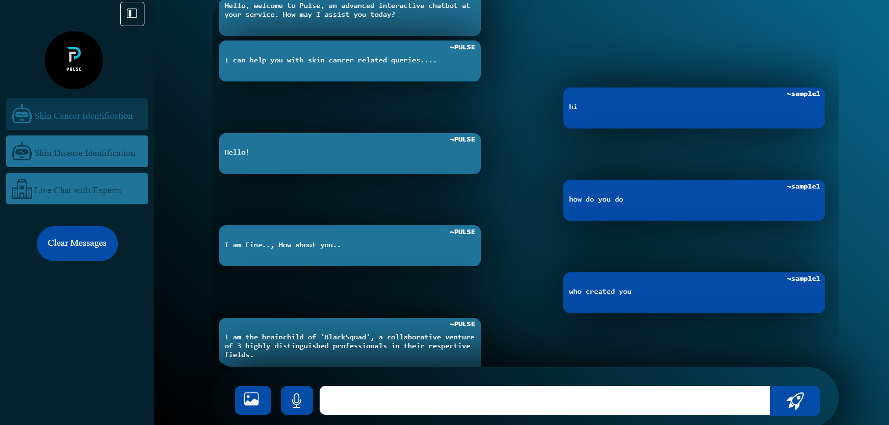
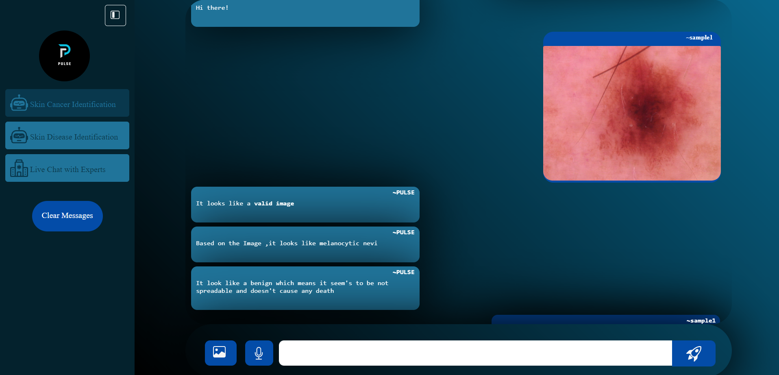
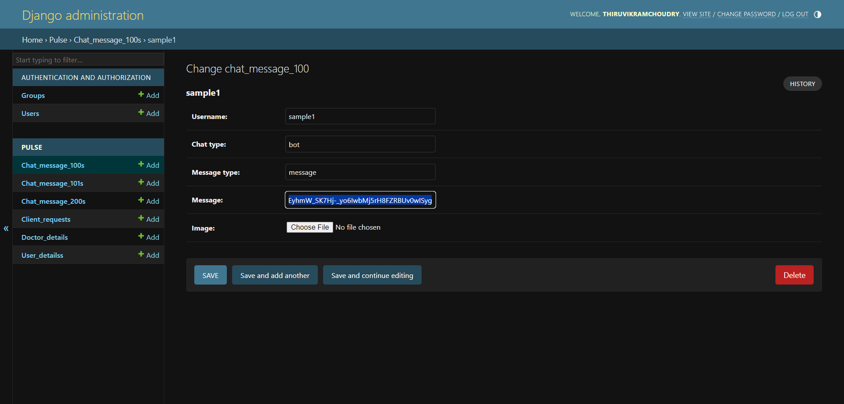
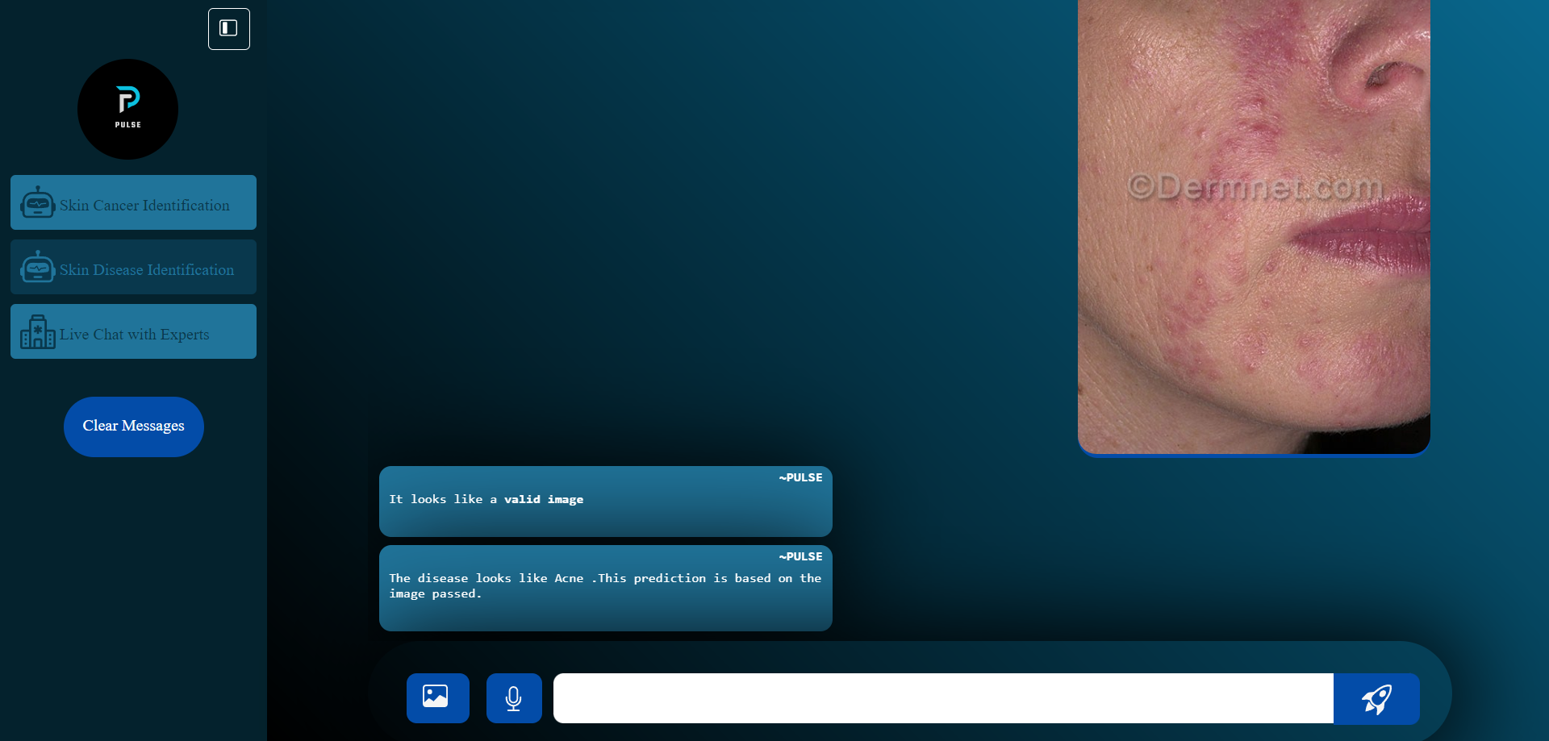
USER INTERFACE
USER INTERFACE
(1)
(2)
(4)
(3)

Slide 12
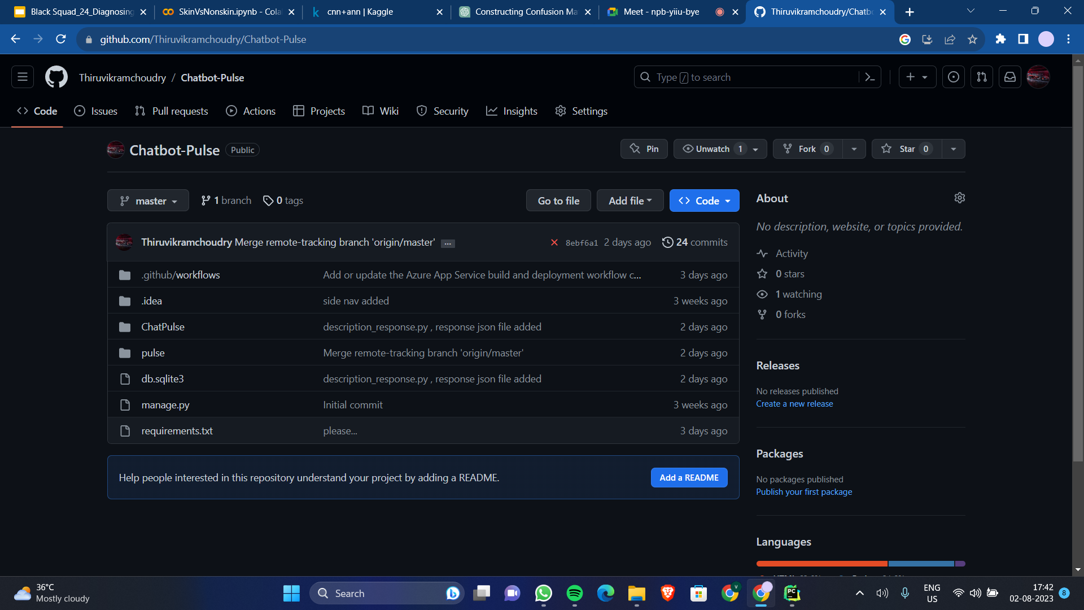
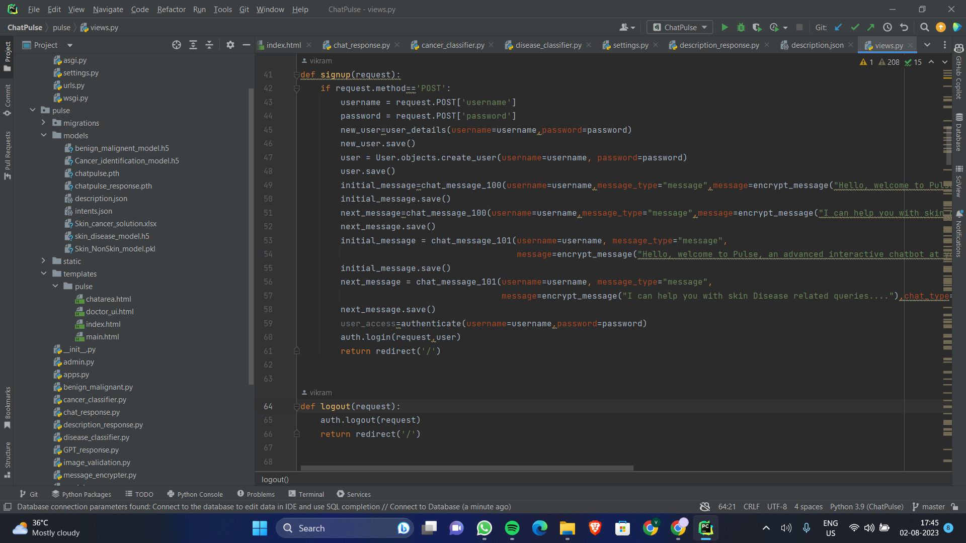
SOURCE CODE
https://github.com/Thiruvikramchoudry/Chatbot-Pulse.git

Slide 13
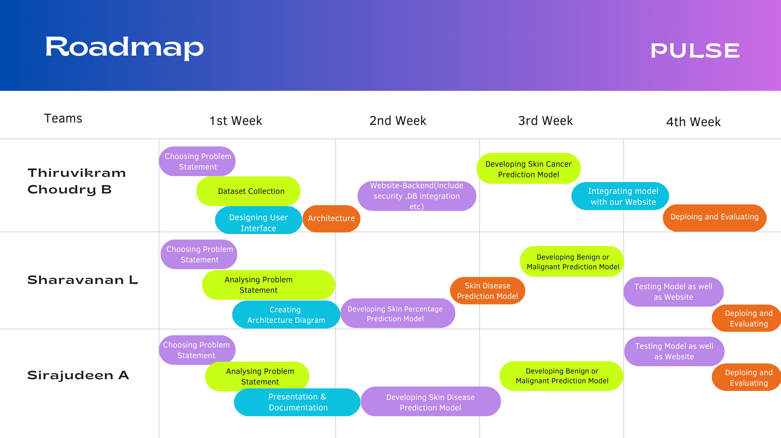

Slide 14
Mentor connect details
Date of connect | Time | Platform | Agenda of the meet
12-07-2023 | 04.00 PM | Gmeet | Idea Review
14-07-2023 | 02:00 PM | Gmeet | Architecture Evaluation,ML Model Alteration
21-07-2023 | 02.00 PM | Gmeet | Model Evaluation
23-07-2023 | 06.00 PM | Gmeet | Security Concerns
26-07-2023 | 02.00 PM | Gmeet | User interface review , chatbot conversation concern’s

Slide 15
THANK YOU

